Slide 1

Automation Project Part 1
Majd Hassoun

Slide 2
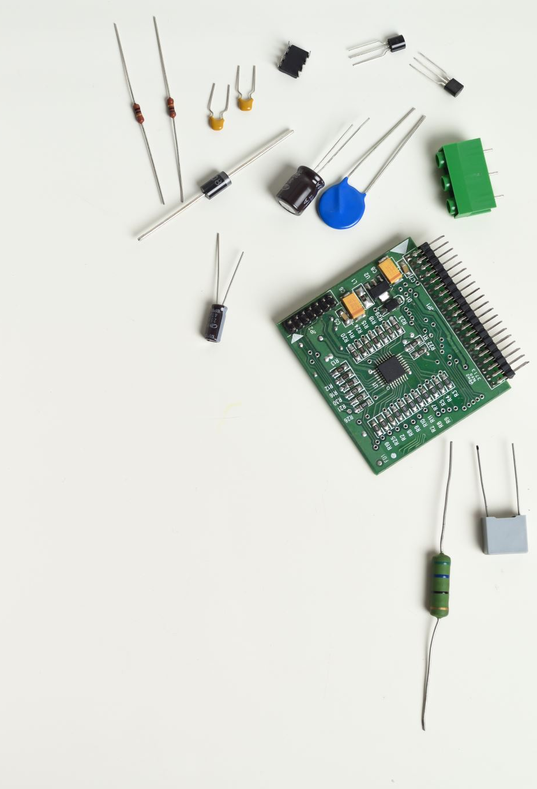
About Me
My name is Majd Hassoun I’m 22 years old from Daliat Al Carmel .
Student at the 5TECH QA Automation program.

Slide 3

WorldCat Website
The WorldCat website is a site where you can search and find a very large number of books, articles, records and many other things that can be found in libraries. The site displays information about each item including the year of publication, the name of the author, a summary, book availability and more.
In addition, the website displays the list of libraries closest to the user's current location, in addition to the possibility of searching many libraries around the world with the option to buy or borrow books and other items through a link that takes you to the website of the desired library.

Slide 4
STP And STD Documents
Like every real-life QA Testing project, we prepared the necessary documents to plan all the stages and details of the whole process, and to make sure that every step is being done properly and according to the plan.
This is why we created and prepared the STP and the STD documents.
In this project we mainly conducted UI and End-To-End testing.
Links to the documents: STP – STP automation project part 1.docx
STD - STD automation project part 1.docx

Slide 5
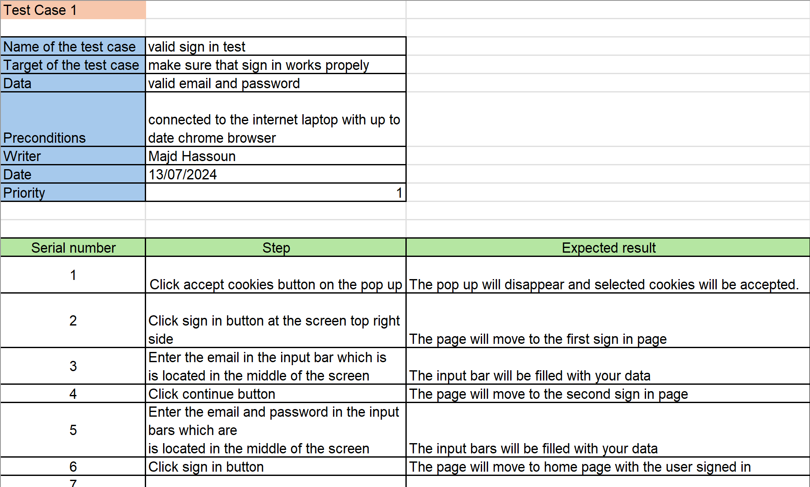
Test Cases From STD Document

Slide 6
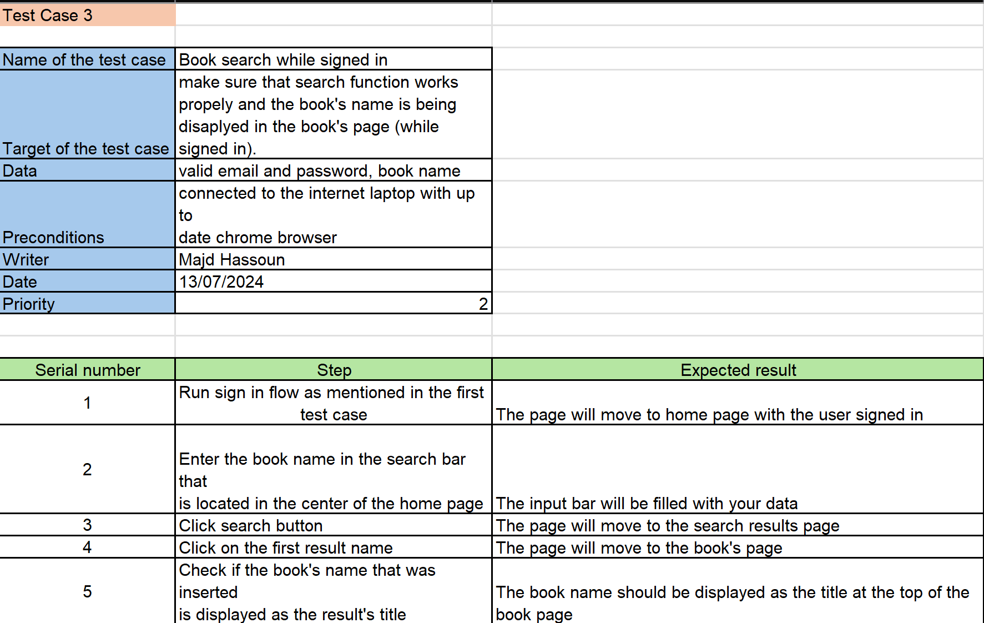
Test Cases From STD Document

Slide 7
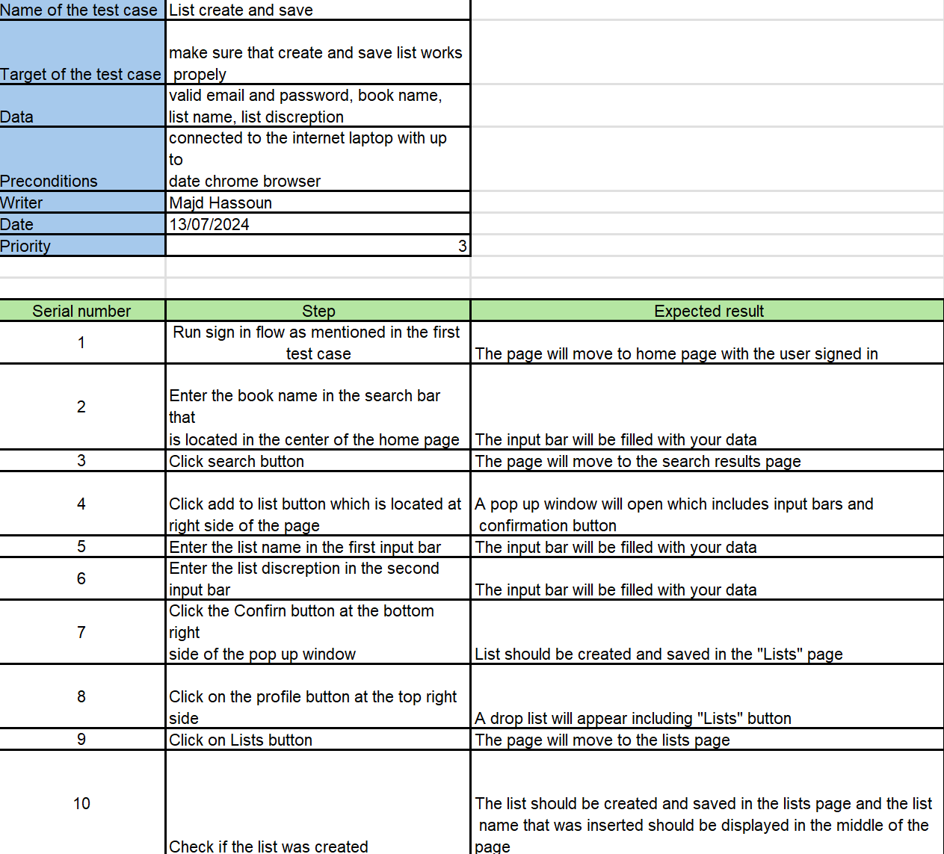
Test Cases From STD Document

Slide 8
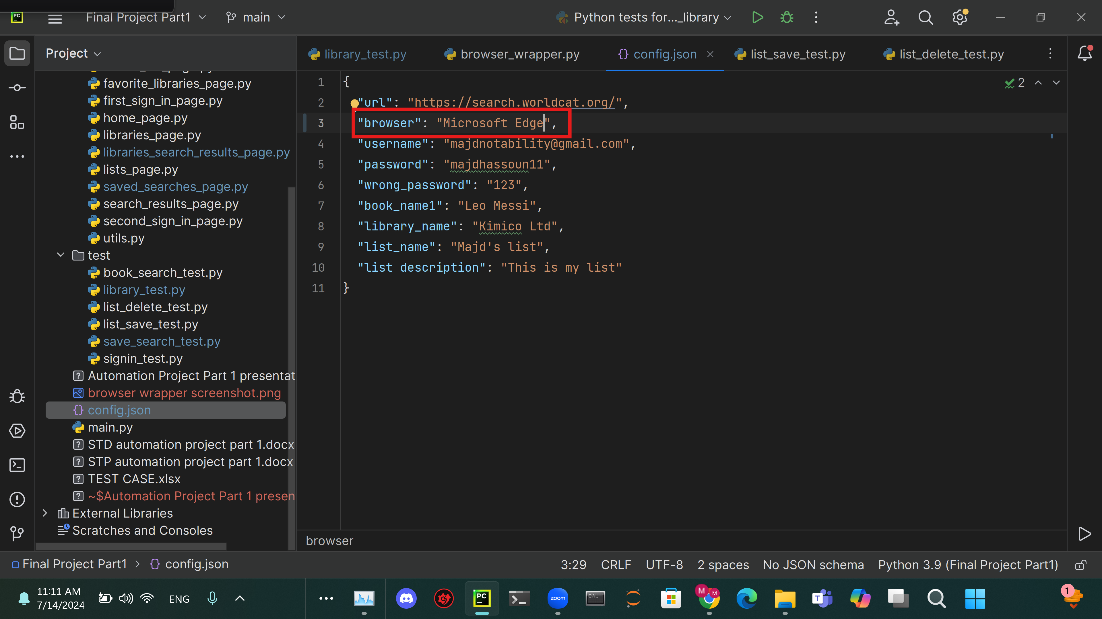
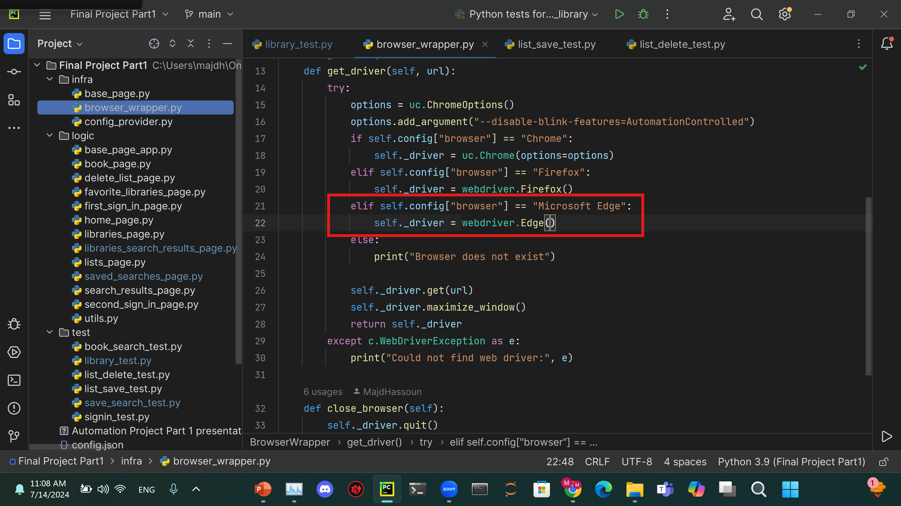
Running The Test With Different Browsers

Slide 9

Now Let’s See The Code Itself

Slide 10

Difficulties And Hurdles During The Project
During the project I faced some difficulties and problems that challenged me.
An example for this is a random bug that suddenly occurred while I making sure that the test are running smoothly and made all the test fail without changing anything in the code, but with some help from my friends (credit for Jameel for helping me with this bug ☺), I managed to solve it.

Slide 11
Thank You For Listening!

